Slide 1

Advantage

Slide 2




Advantage
Manage medical record
Nguyễn Trung Nam

Slide 3
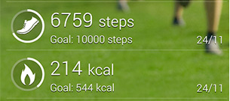
Advantage
Tracking patient’s practice data

Slide 4

Advantage
Support doctor make food ingredient, prescription.

Slide 5
Main Function

Slide 6
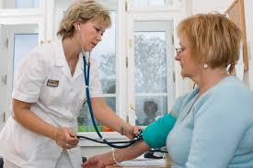
Main Function
Register examination

Slide 7
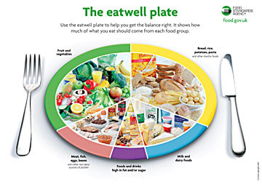
Main Function
Make food ingredient

Slide 8

Main Function
Suggest treatment

Slide 9
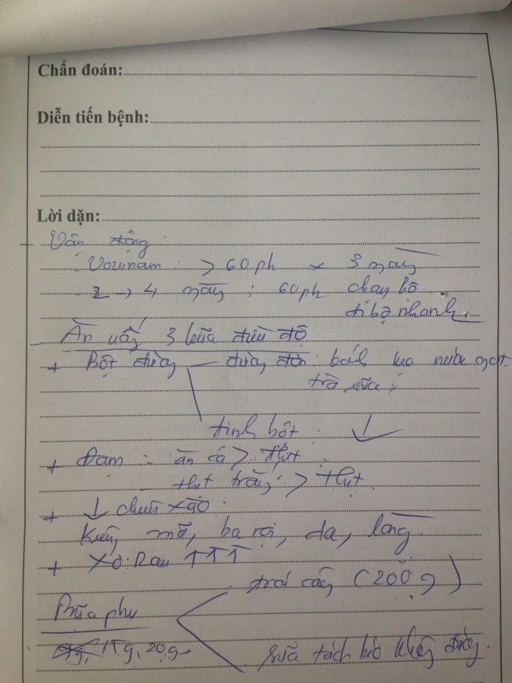
Main Function
Make prescription

Slide 10
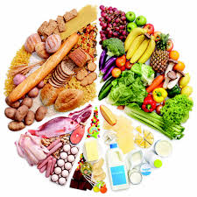

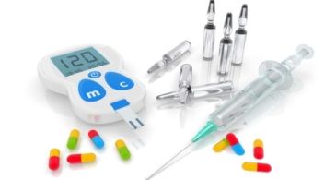

Main Function
Remind patient in treating

Slide 11
Main Function
Get patient’s practice data

Slide 12
Scope of System

Slide 13


Scope of System
Treating with patient 20 – 60 ages.

Slide 14

Scope of System
System doesn’t support patient make appointment with doctor.
Setup meeting

